Slide 1

Lesson 3 POLYHEDRONS
Week 5
Math 13
Solid Mensuration
Notes:
Week 5

Slide 2
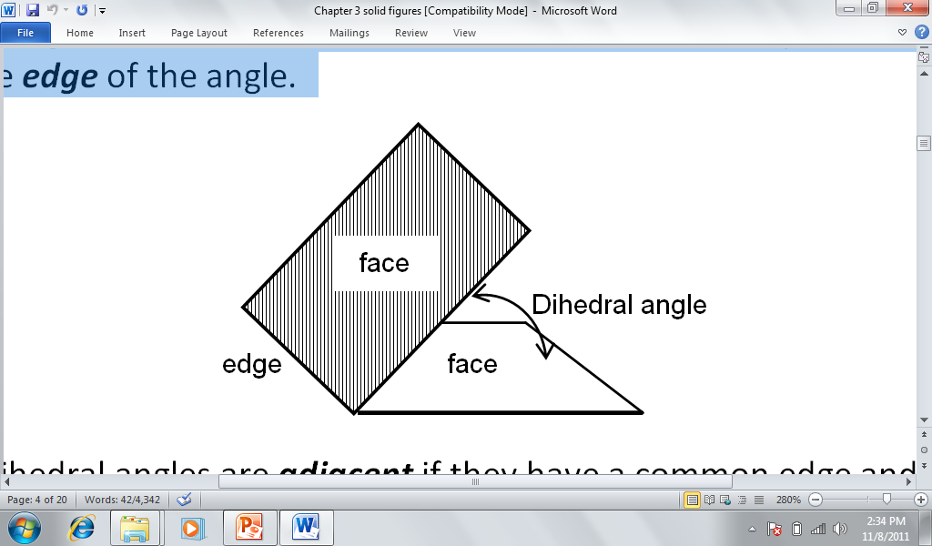
Dihedral Angles
The dihedral angle is the angle formed between two intersecting planes. In the figure shown, the two planes are called faces of the dihedral angle, and the line of intersection between the planes is called the edge of the angle.
Reference: Solid Mensuration by Richard Earnhart
Notes:
Week 5

Slide 3
Polyhedral Angles
A polyhedral angle is the angle formed by three or more planes which meet at a common point.
The common point is called the vertex of the angle. The intersecting planes are the faces of the polyhedral angle. The lines of intersection of these faces are called the edges. A plane which cuts all the faces of a polyhedral angle (except at the vertex) is called a section.
A face angle is the angle at the vertex and formed by any two adjacent edges. A dihedral angle of the polyhedral angle is the dihedral angle formed by any two intersecting faces.

Slide 4
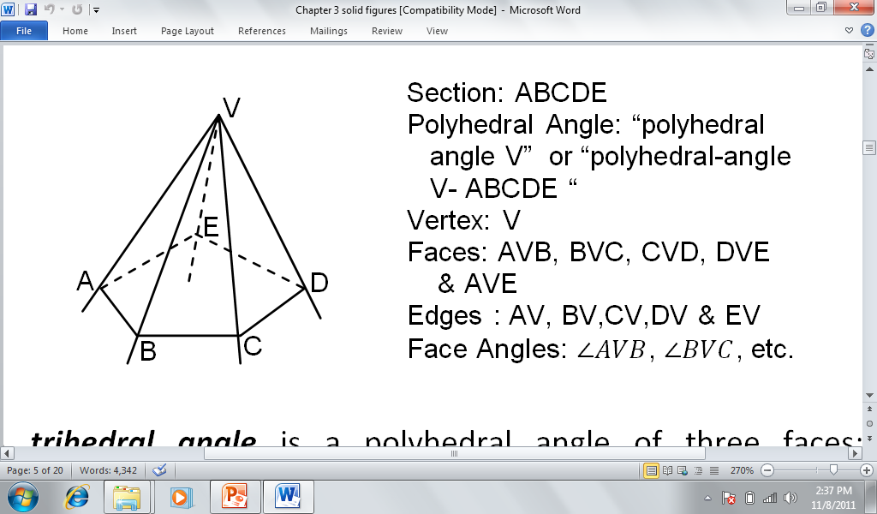

Slide 5
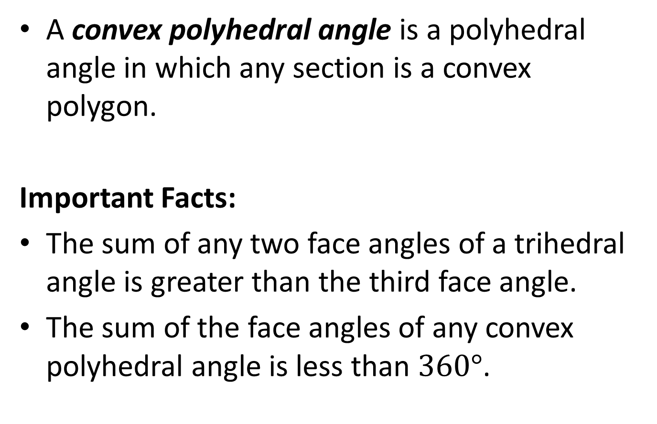
A convex polyhedral angle is a polyhedral angle in which any section is a convex polygon.
Important Facts:
The sum of any two face angles of a trihedral angle is greater than the third face angle.
The sum of the face angles of any convex polyhedral angle is less than $360°$.

Slide 6
The projection of a straight line upon a plane, not perpendicular to the line, is also a straight line.
The angle that the line makes with its projection on a plane is called the angle of inclination of a line to a plane.

Slide 7
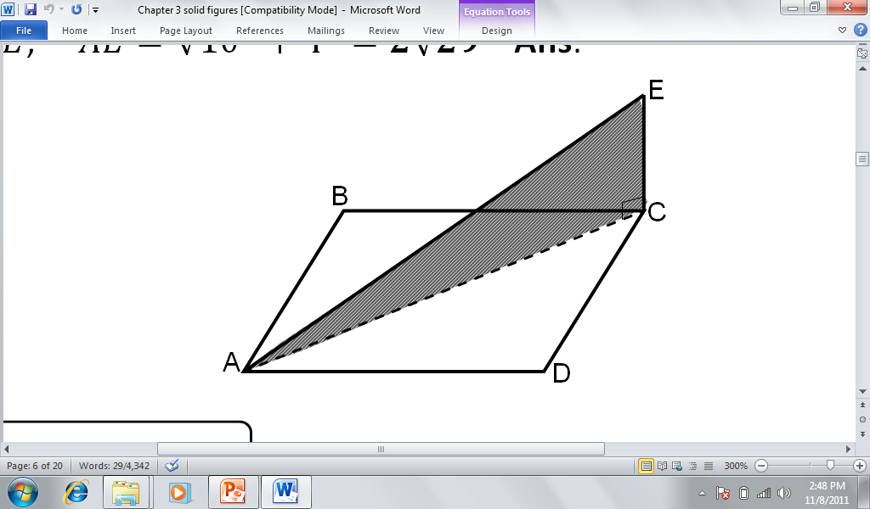

Example 1, p78
$ABCD$ is a rectangle, with $AB=8 in$ and $BC=6 in$. $CE$ is drawn perpendicular to both $CD$ and $BC$ at $C$. If $EC=4 in.$, find the length of $AE$.

Slide 8
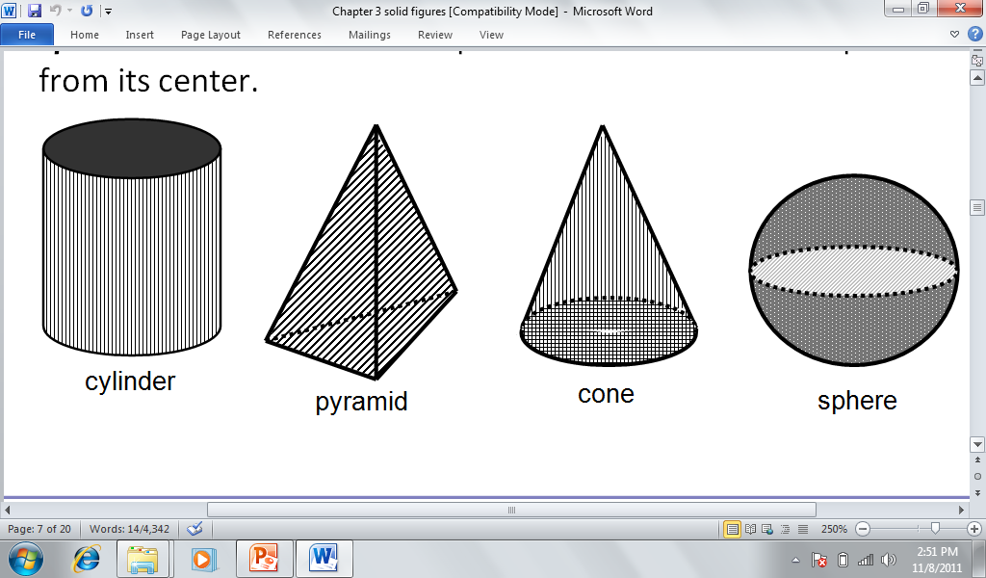
A solid is any limited portion of space bounded by surfaces or plane figures.

Slide 9
Volume and Surface Area of Solids
The volume of a solid is the amount of space it occupies. It has units of cubic length (i.e., cm³, m³, in³, ft³, etc.).
The surface area is the area of a three-dimensional surface.
The lateral area of a solid considers only the areas of the lateral or the side surfaces.
The total surface area includes both the lateral area and the area of the bases (top and bottom). Thus, the total surface area may be defined as the total area of all surfaces that bound the solid.

Slide 10
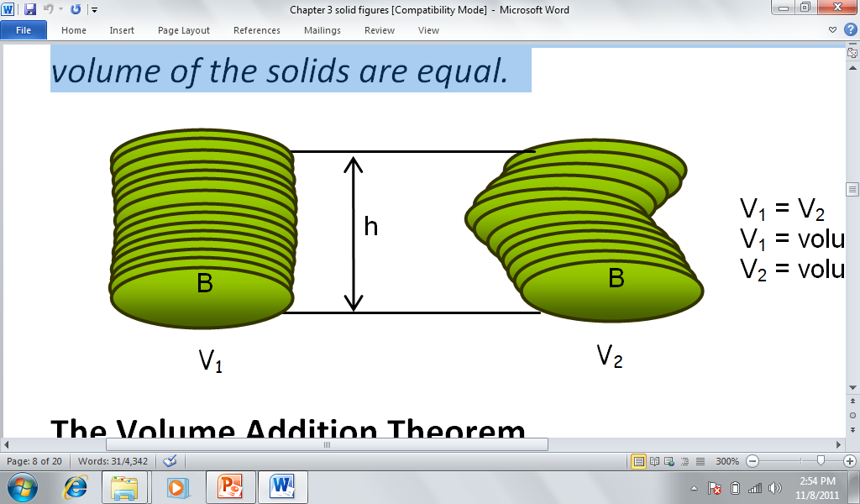
The Cavalieri’s Principle
Given any two solids included between parallel horizontal planes; if every right section has the same area in both solids, then the volume of the solids are equal.

Slide 11
The Volume Addition Theorem
The volume of the region enclosed by a solid may be divided into non-overlapping smaller regions so that the sum of the volumes of these smaller regions is equal to the volume of the solid.

Slide 12
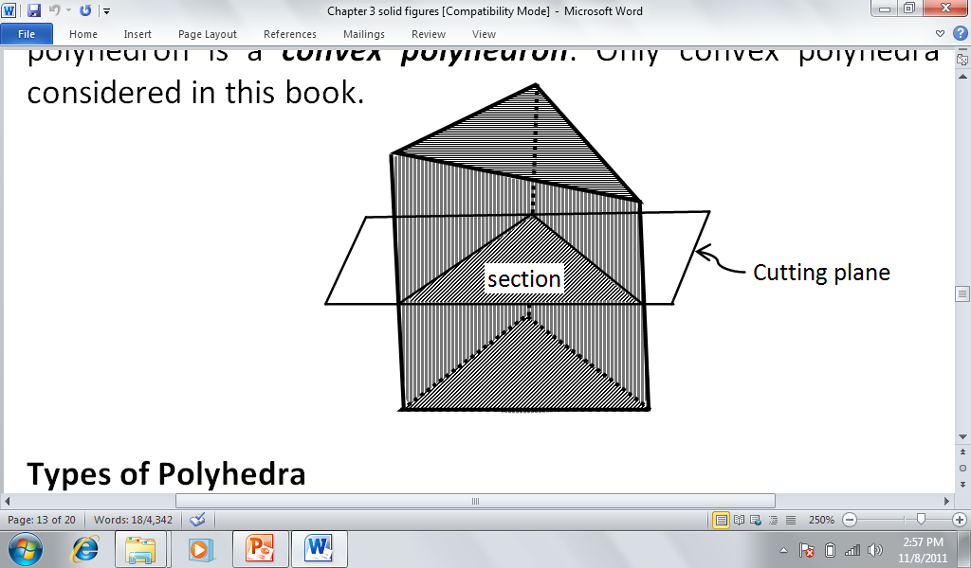
A polyhedron (plural polyhedra or polyhedrons) is a solid which is bounded by polygons joined at their edges.

Slide 13
Polyhedrons are called regular polyhedra or platonic solids if their faces are congruent regular polygons and their polyhedral angles are equal.

Slide 14
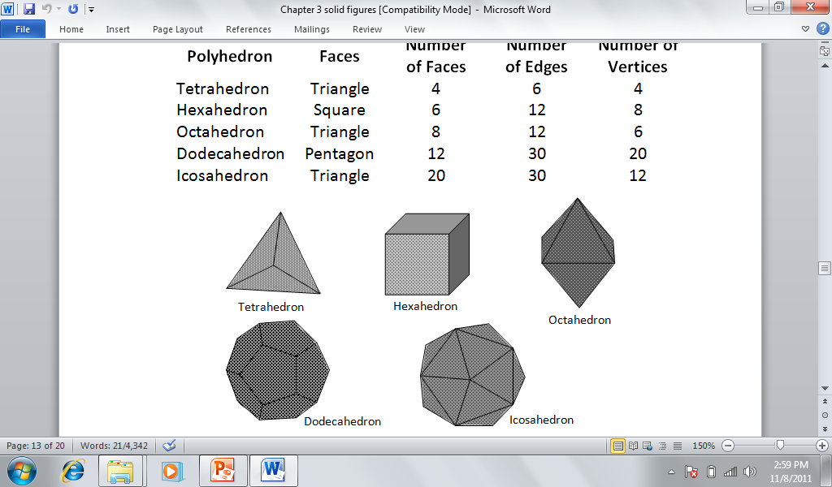

Slide 15
Similar Figures
Two polyhedra are said to be similar if they have the same number of faces that are similarly placed, and which corresponding polyhedral angles are congruent. Corresponding dimensions (lengths of lines such as edge, height, etc) of similar figures are also proportional.

Slide 16
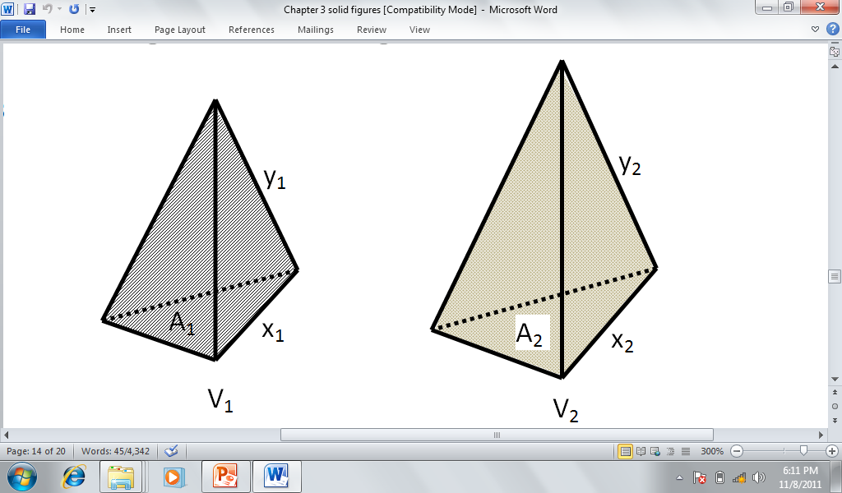
Similar Figures

Slide 17
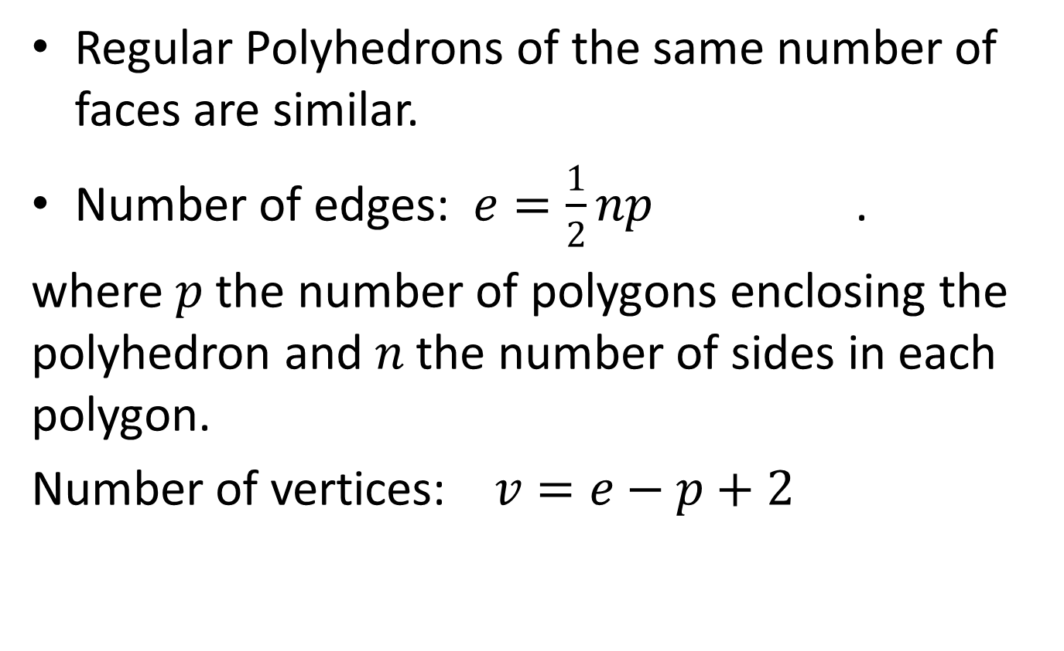
Facts About Regular Polyhedrons
Regular Polyhedrons of the same number of faces are similar.
Number of edges: $e=\frac{1}{2}np$ .
where $p$ the number of polygons enclosing the polyhedron and $n$ the number of sides in each polygon.
Number of vertices: $v=e−p+2$

Slide 18
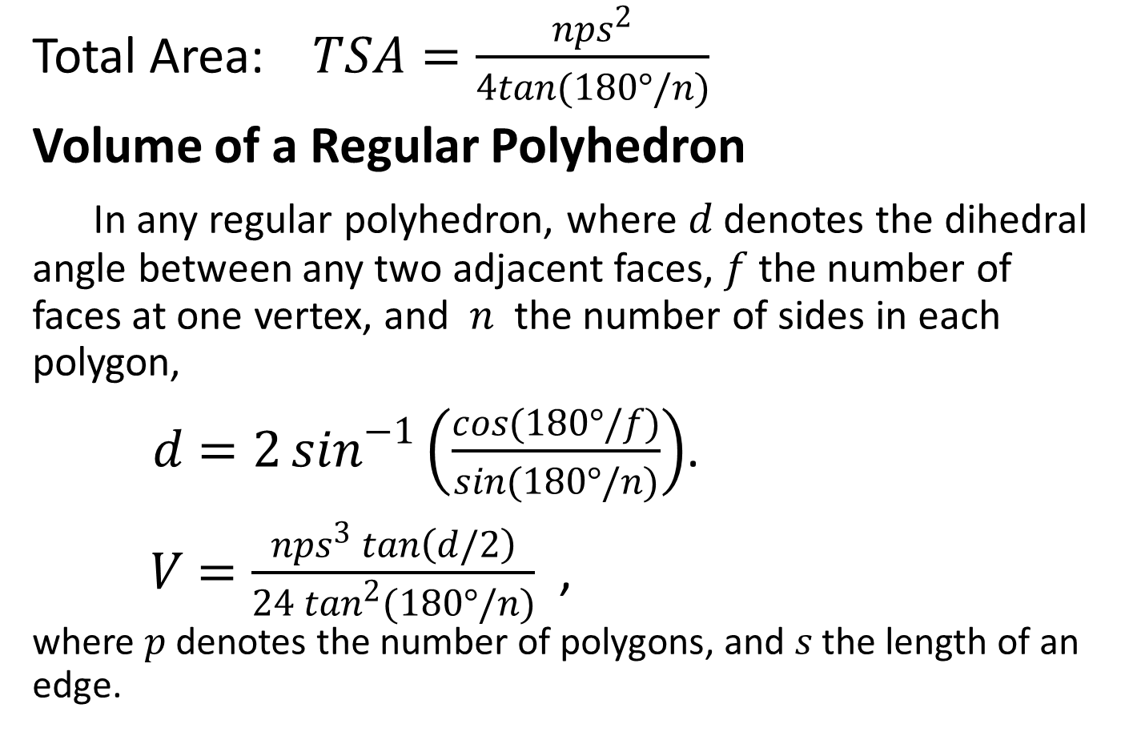
Total Area: $TSA=\frac{nps^{2}}{4tan(180°/n)}$
Volume of a Regular Polyhedron
In any regular polyhedron, where $d$ denotes the dihedral angle between any two adjacent faces, $f$ the number of faces at one vertex, and $n$ the number of sides in each polygon,
$d=2\sin^{−1}\left(\frac{cos(180°/f)}{sin(180°/n)}\right)$.
$V=\frac{nps^{3}\tan\left(d/2\right)}{24\tan^{2}{(180°/n)}}$, where $p$ denotes the number of polygons, and $s$ the length of an edge.

Slide 19
Example 7
Find the dihedral angle formed by any two adjacent faces, the total area and the volume of a regular tetrahedron if the measure of one edge is 10 inches.
ANS: TSA=173.2 sq.in.
V=117.85 cu.in.

Slide 20
Problems
#7 Page 84: The sides of an equilateral triangle are 6 cm each. Find the distance between the plane of the triangle and a point P which is 13 cm from each vertex of the triangle.
#9 Page 92: Find the volume of a regular dodecahedron if the total area is 2498 ft².

Slide 21
Homework
#3, 9 Pages 83-84
#3, 5, 7 & 11 Page 92

